Slide 1


MIDNAPORE COLLEGE(AUTONOMOUS)
E-BOOKLIBRARY MANAGEMENT SYSTEM
Presented by:- SUBHAM SARKAR
Roll no:- 2636, UG, BCA
Registration no:- 2018-1618
SUBJECT: BCA , PAPER CODE: 605
DEPARTMENT OF COMPUTER SCIENCE AND APPLICATION
Guided By:- Santi pada Dua
(Assistant professor of Computer science & Application Department)

Slide 2
INDEX
INTRODUCTION OF E-BOOKLIBRARY MANAGEMENT SYSTEM PROJECT
HOME PAGE
USER REGISTRATION PAGE
USER LOG IN PAGE
User home page and computer book related page
USER SEARCH & USER ALL BOOKS SECTION
ADMIN HOMEPAGE & ADMIN BOOK UPLOAD, DOWNLOAD, DELETE, EDIT & PREVIEW PAGE
CONCLUSION & FUTURE SCOPE
THANK YOU PAGE

Slide 3
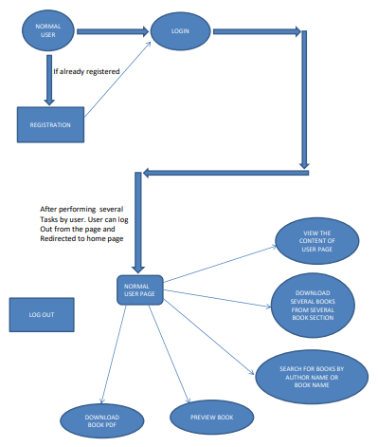
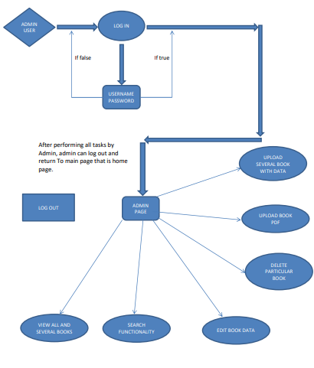
INTRODUCTION OF E-BOOKLIBRARY MANAGEMENT SYSTEM PROJECT
E-Booklibrary Management System is an application which refers to library systems . It is used by the admin of the website to manage the library using a computerized system where admin can add new books along with book data , edit books, preview & delete that book and users can view ,read, download that book.
FEATURES OF THIS PROJECT :
For Users:
Online book reading by clicking preview button of the book card.
User registration and log in feature included for security purpose.
A search bar presents to search availability of books by author name and book name.
Facility to download required book.
Facility to view particular book on particular book section for better experience.
Facility to view all books in books gallery section
User registration & login page for security purpose.
google map included feature.
Download pdf format of particular book feature.
For Admin:
Log in feature included for security purpose.
Upload several books to several books section.
Edit , delete, preview , download, upload feature included.
Search option included.
Full website access feature.
User DFD
Admin DFD

Slide 4
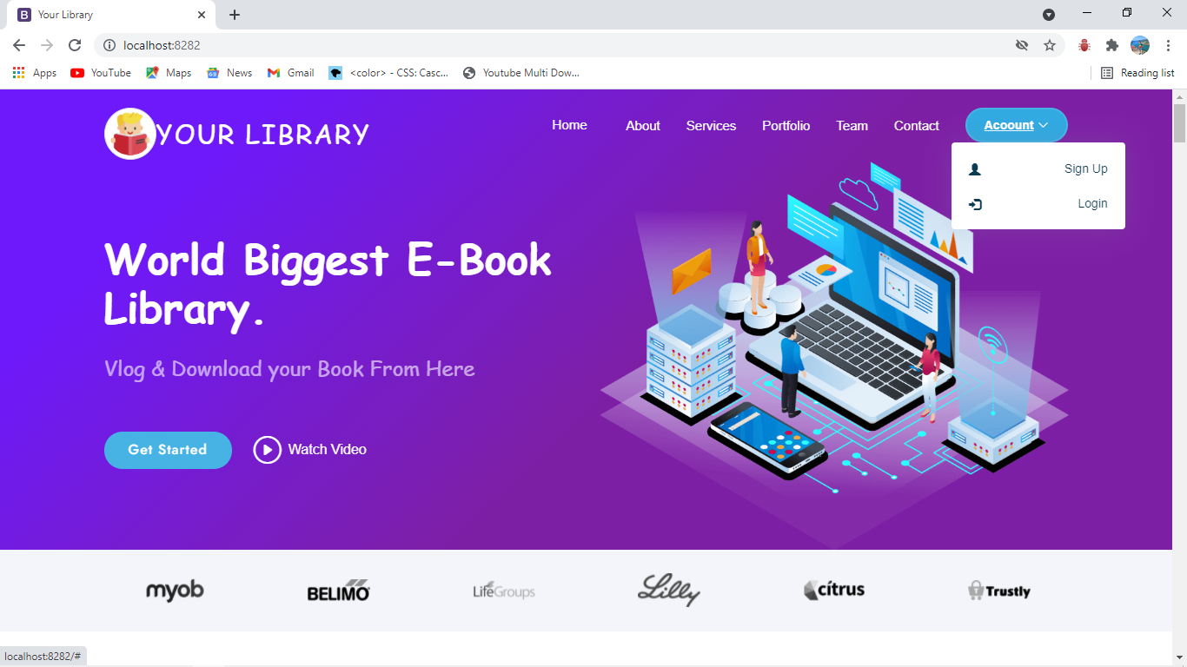
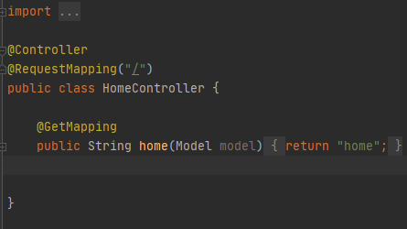
HOME PAGE
The class is flagged as a @Controller, meaning it is ready for use by Spring MVC to handle web requests. These mark controller classes as a request handler to allow Spring to recognize it as a RESTFUL service during runtime.
RequestMapping annotation is used to map web requests onto specific handler classes and/or handler methods. @RequestMapping can be applied to the controller class as well as methods. @RequestMapping maps `/ ’ to the home()method. When invoked from a browser or by using curl on the command line, the method returns pure text. That is because @Controller and @ResponseBody, two annotations that results in web requests returning data rather than a view.
@GetMapping annotation maps HTTP GET requests onto specific handler methods. It is a composed annotation that acts as a shortcut for @RequestMapping(method = RequestMethod.GET).

Slide 5

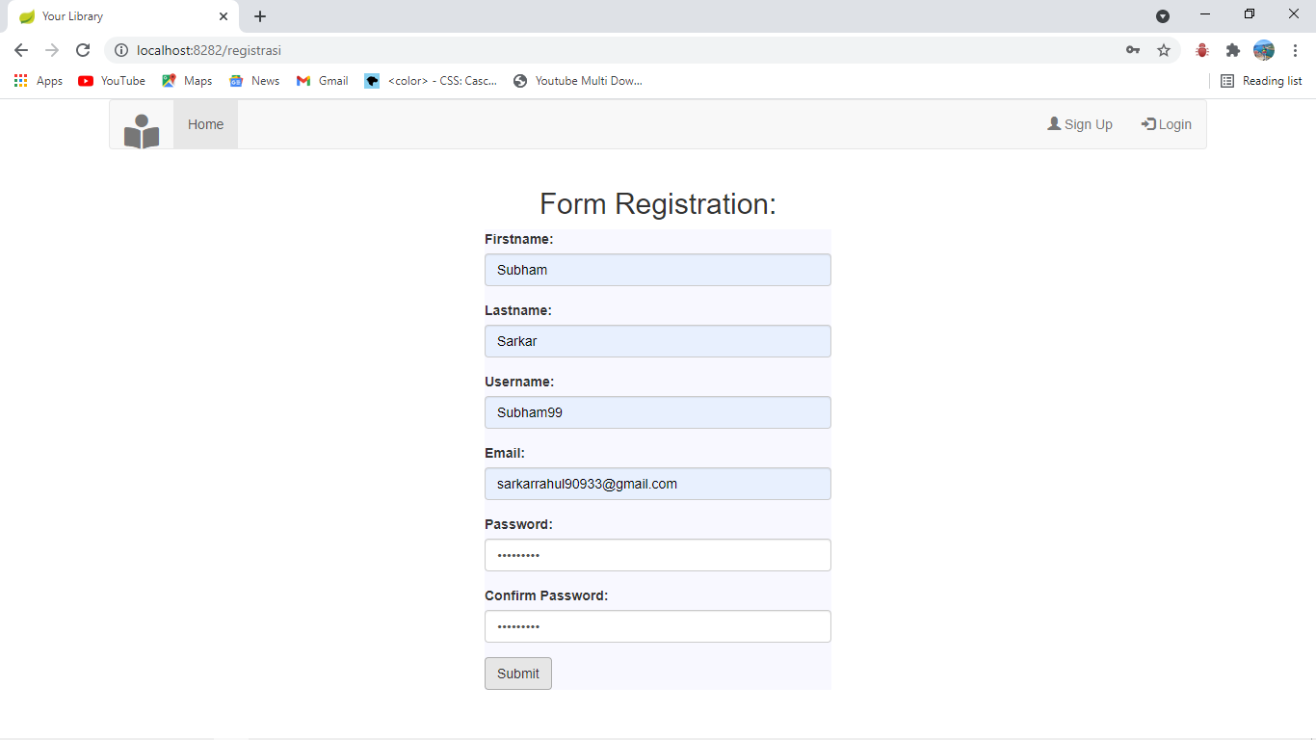
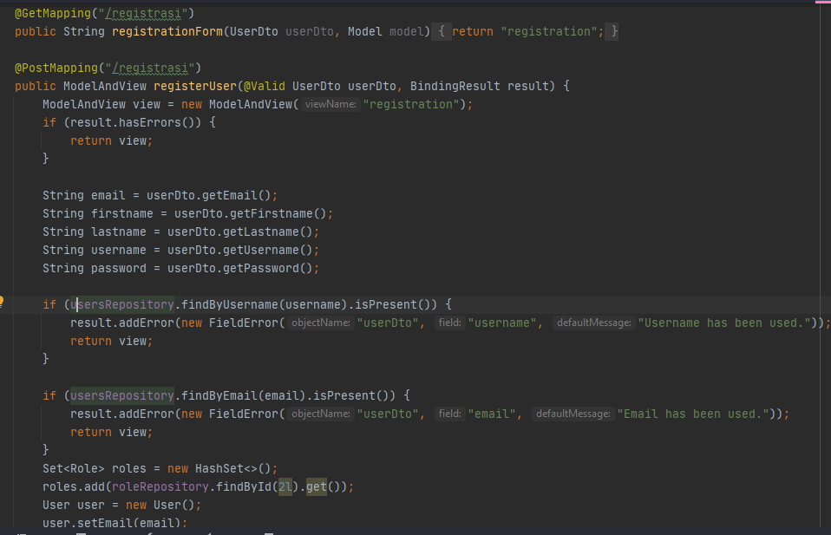
USER REGISTRATION PAGE
Here GetMapping /register annotation maps HTTP Get request of registration.html page and return the registration .html page content.
PostMapping helps to post or save the input datais in User dto class where I define the schema entities like first name, last name as an object. This user dto class bind with user repository interface, where I define all JPA custom finders methods. And if there any same user name or email address present in the schema then I through the error message as “ Email Has Been Used or UsernameHas Been Used ”.
If all things goes in right way, then set the role of registered user @role repository interface which was bind with role class which was also a table of librarymanagement schema.
After setting role of that registered user I save (usersRepository.save(user);) all the details @userrepository interface which was bind with user class. User is a table of library management schema.

Slide 6
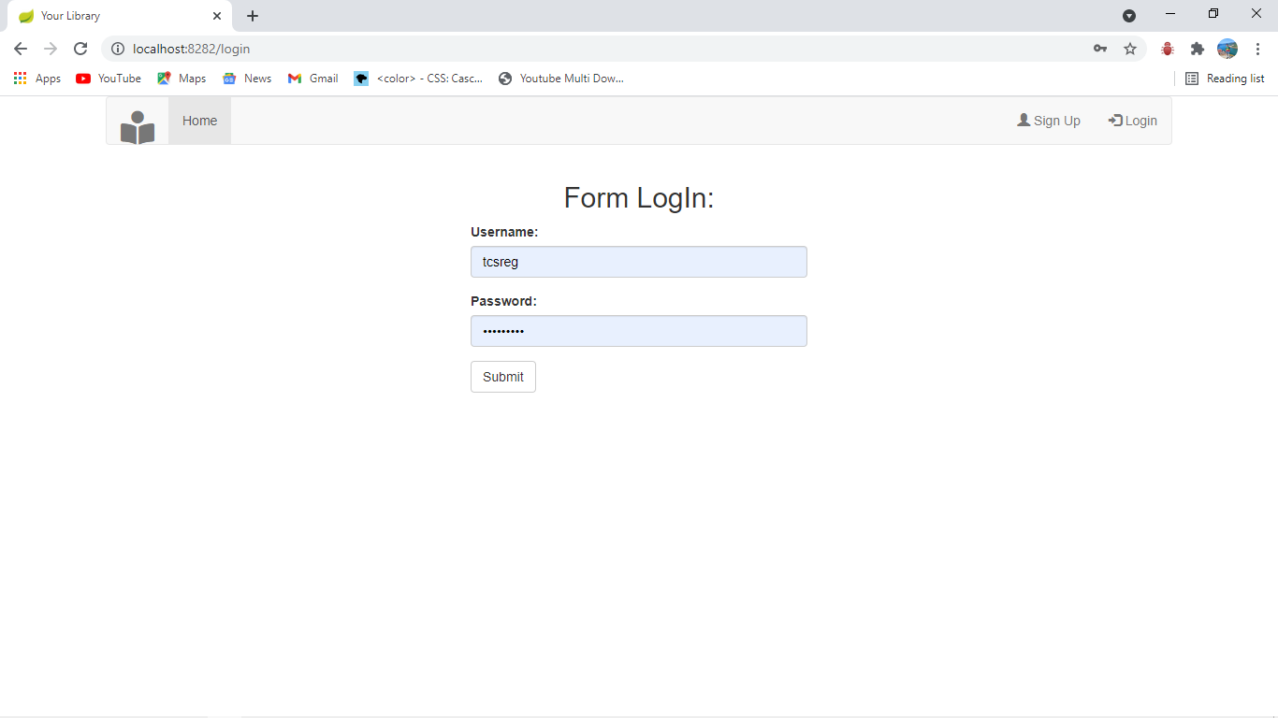
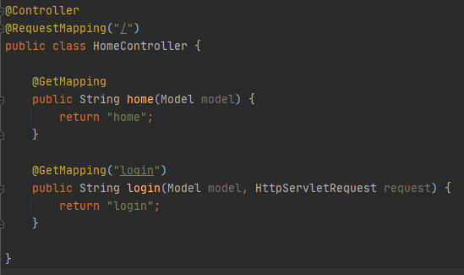
USER LOG IN PAGE
Here GetMapping login annotation maps HTTP Get request of login.html page and return the login.html page content.
I submit this form with /post method . Which was navigate to the user table of the library management schema. If the inputs was true then the form will be submited and a new page named user page opens, which I discuss next.
This form’s input values are saved in registration process in user table and also set the role of that registered user in user role table using these two following codes.
Set<Role> roles = new HashSet<>(); roles.add(roleRepository.findById.get());

Slide 7
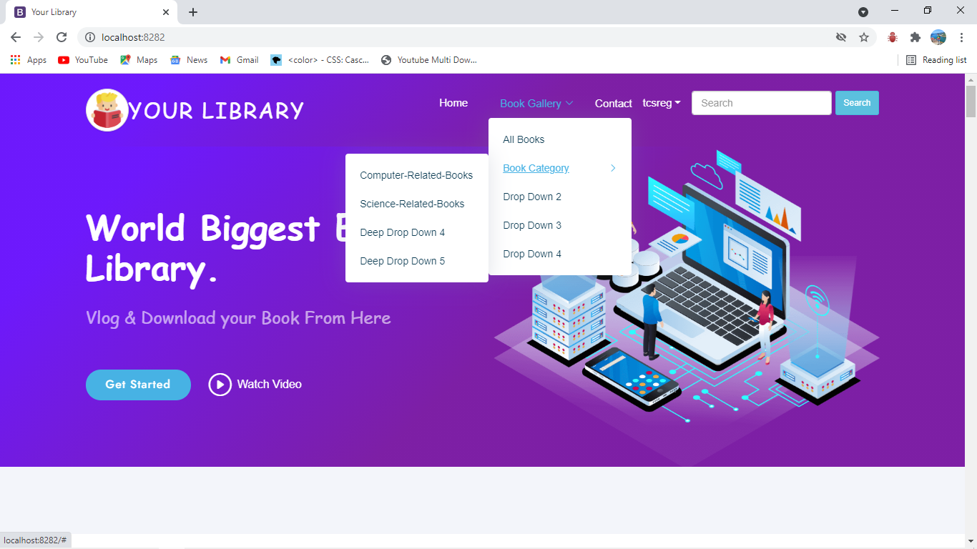
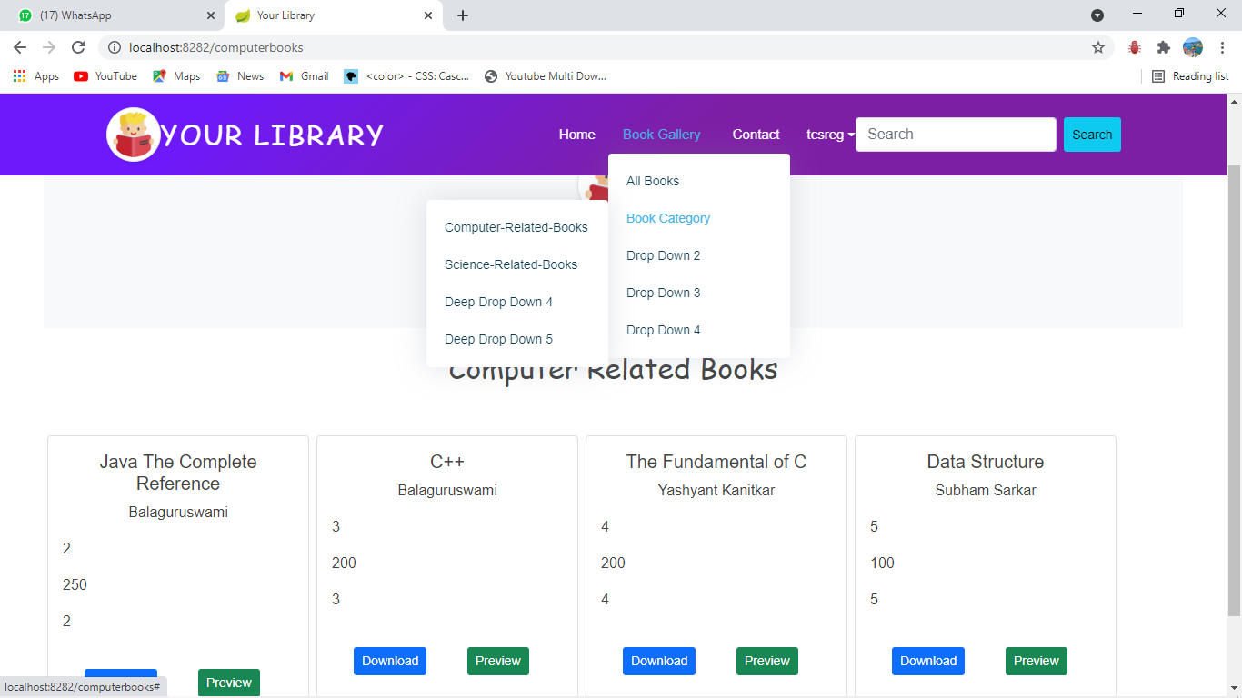
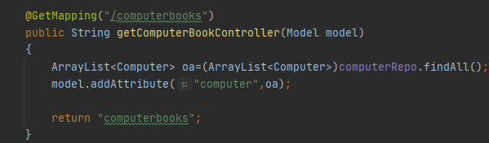
User home page and computer book related page
in this user home page no need to define getmapping as I already map home page with GetMapping controller. The reason behind this I use spring security in home.html page and there I devided home.html page into three section with spring security, 1.normal home page, 2.user home page and 3.admin home page.
With the help of array list I can dynamically accessed the computer table elements by their indexes.
And computer table is merge with interface computer repo for crud operations like findall method. After that I return all the elements of computer table with the help of GetMapping ‘/computerbooks’ in computer book.html page.

Slide 8
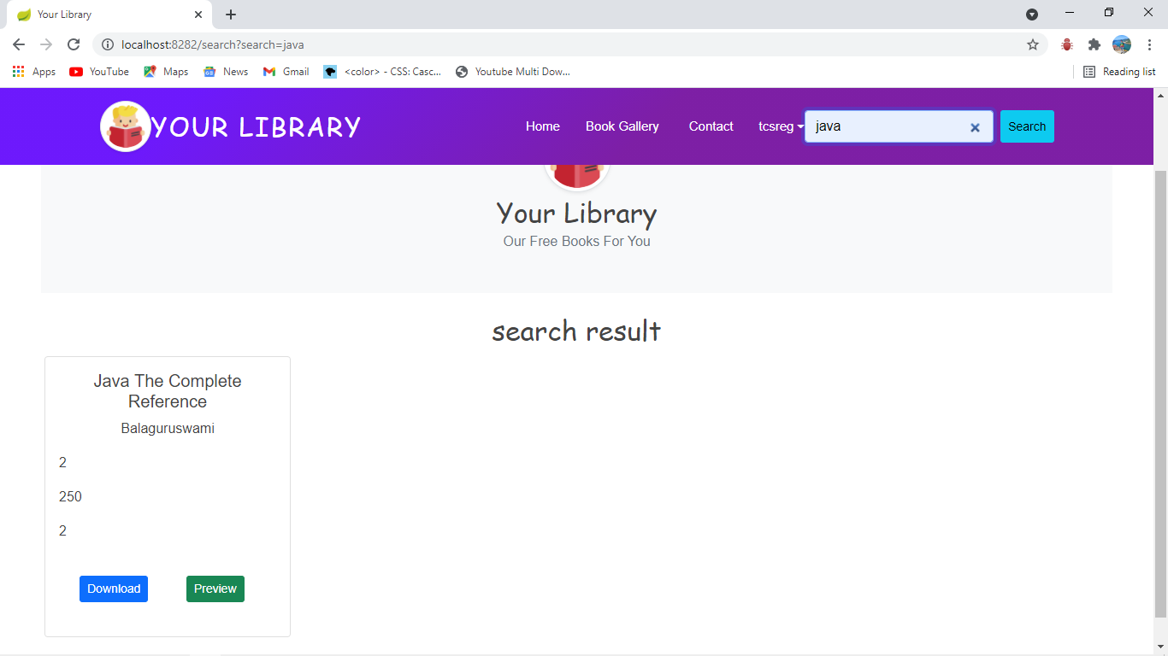
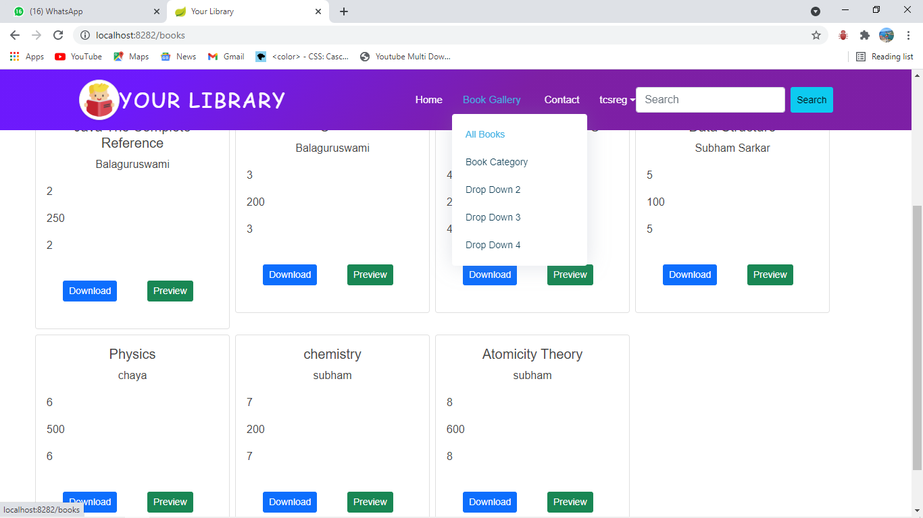
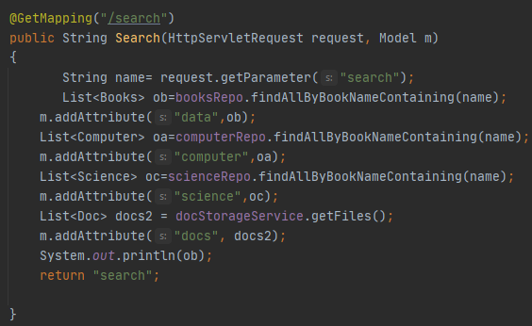
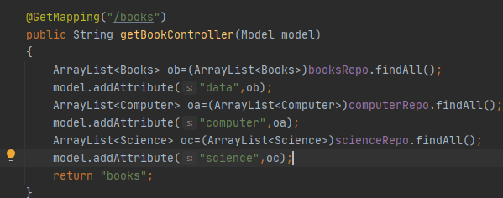
USER SEARCH & USER ALL BOOKS SECTION
I create a html page named search where I return the elements of computer book table, science book table entities with the help of find all method with was a crud operation define in computer books,science book and all books repository. And after that with the help of get mapping I return all the stuffs @Search.html page
With the help of array list and findall crud operation I return all the books from various repository to all books.html page.

Slide 9
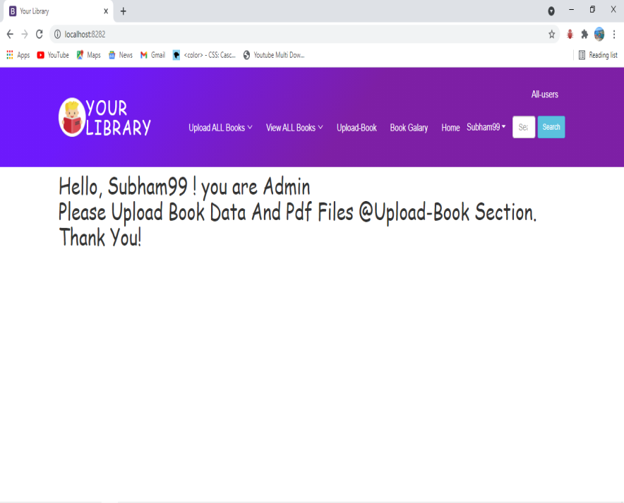
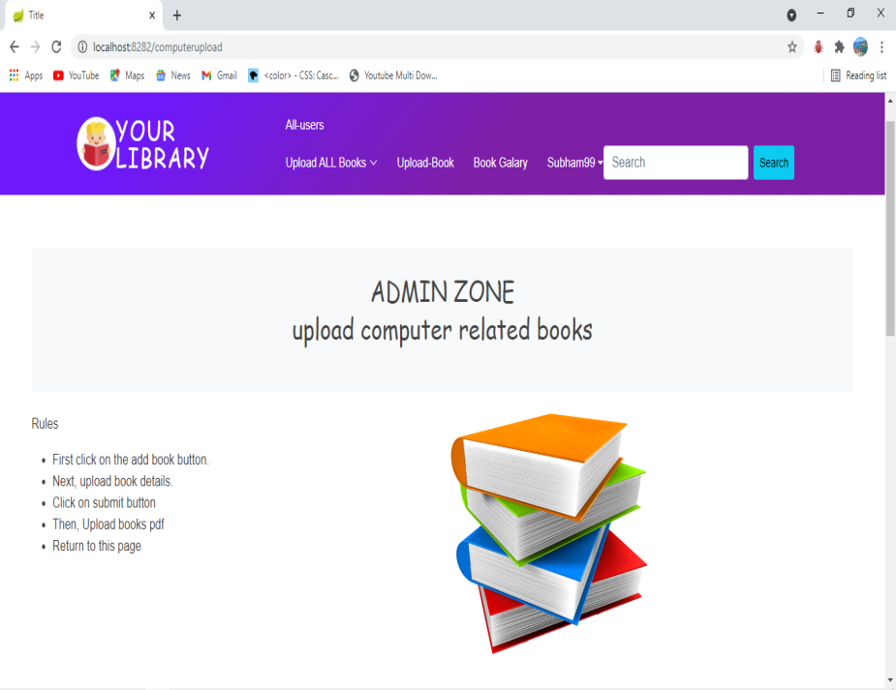
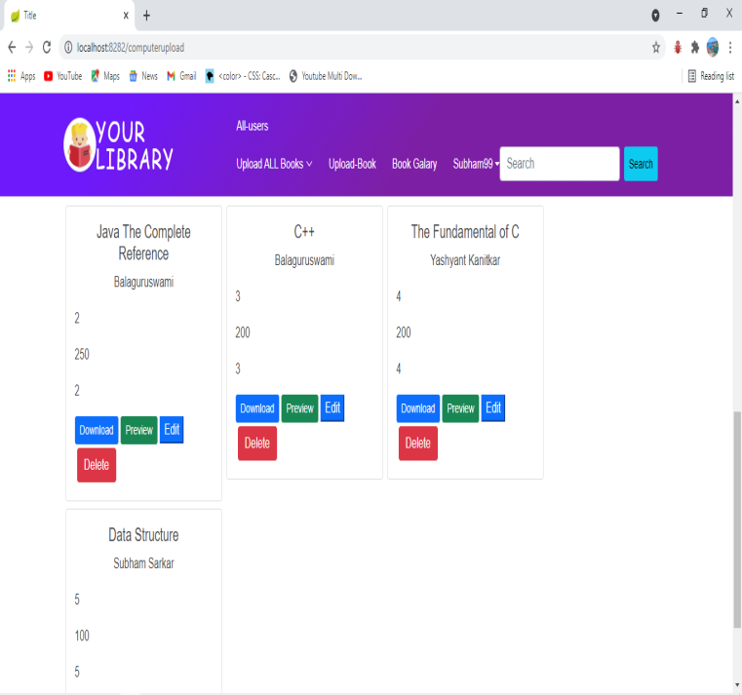
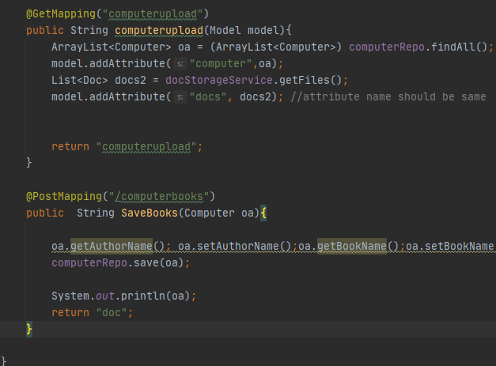
ADMIN HOMEPAGE & ADMIN BOOK UPLOAD, DOWNLOAD, DELETE, EDIT & PREVIEW PAGE
in this admin home page no need to define getmapping as I already map home page with GetMapping controller. The reason behind this I use spring security in home.html page and there I devided home.html page into three section with spring security, 1.normal home page, 2.user home page and 3.admin home page.
With the help of PostMapping @Computerbooks I save the books details along with book data @computer table in library management database. And after that I return doc.htmlpage for uploading the pdf file of that particular book.

Slide 10
CONCLUSION & FUTURE SCOPE
This website provides a computerized version of library management system which will benefit the students.
It makes entire process online where student can search books, and download book pdf. It also has a facility for users login where student can login and register themselfs. It has a facility of admin login where admins can add lectures notes.
There is a future scope of this facility that many more features such as online lectures video tutorials can be added by admins as well as online assignments submission facility , thus making it more interactive more user friendly and project which fulfills each users need in the best way possible.

Slide 11
References
http://www.w3schools.com/html/html_intro.asp
http://spring.io/guides/gs/spring-boot/
http://spring.io/guides/tutorials /spring-boot-kotlin/
http://www.springboottutorial.com/
https://www.youtube.com/watch?v=729Pd-ZQ4uA&list=PL0zysOflRCelmjxj-g4jLr3WKraSU_e8q

Slide 12


